Slide 1
2022-09-Front End Software Development GitHub Installation
Week 1 assignment
Enrique Gasca, MBA @2022

Slide 2


Slide 3
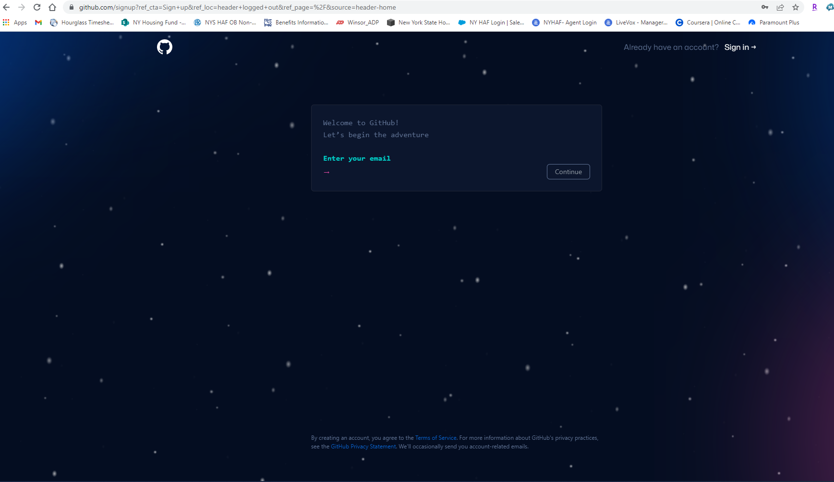

Slide 4
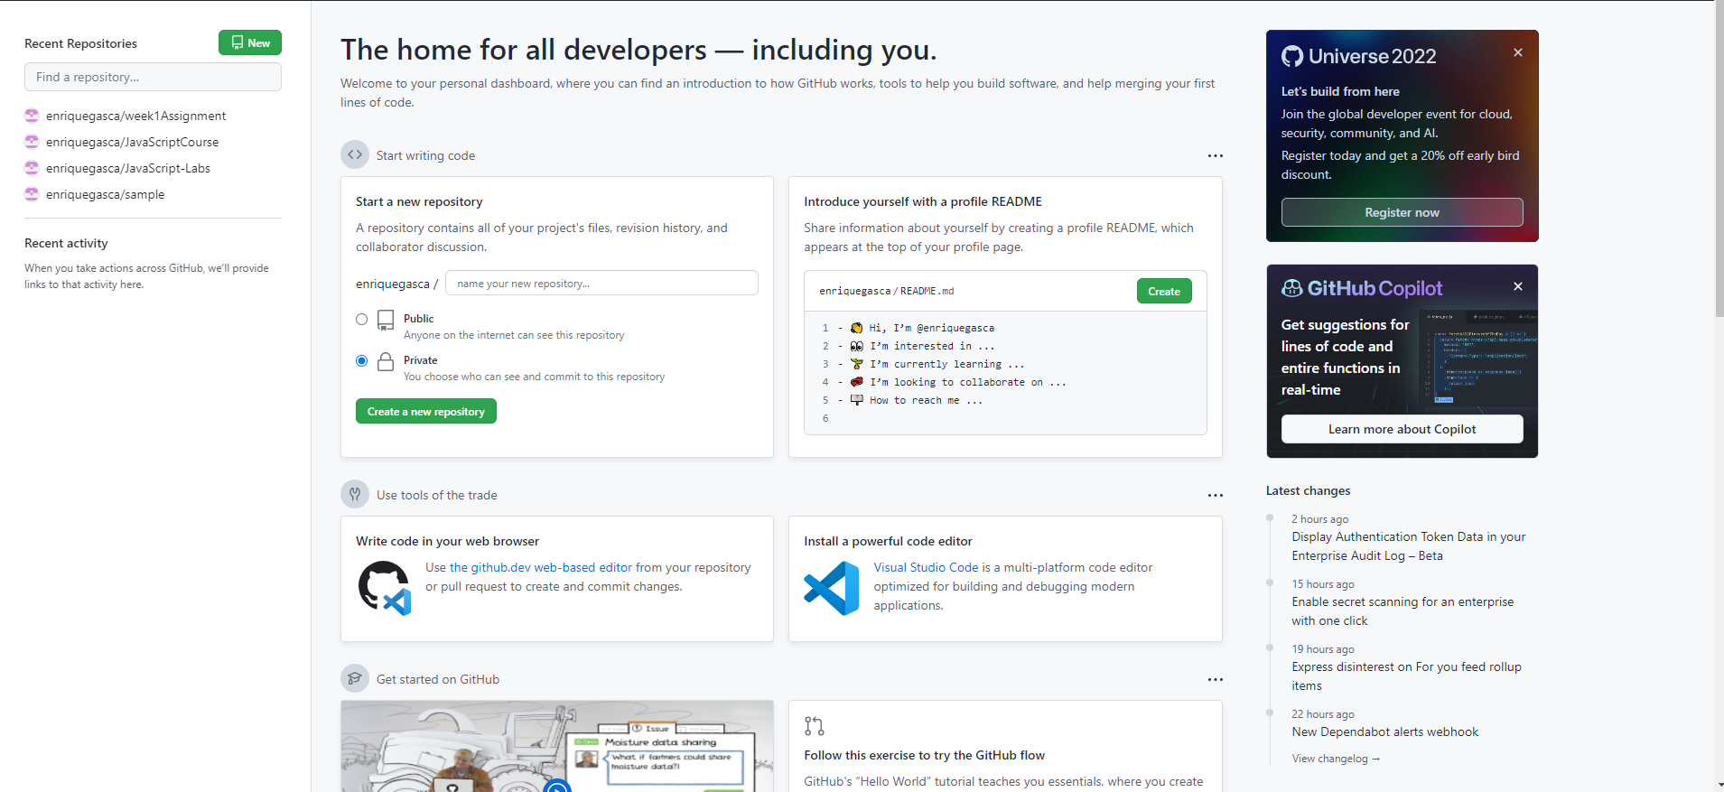
Choose either one

Slide 5
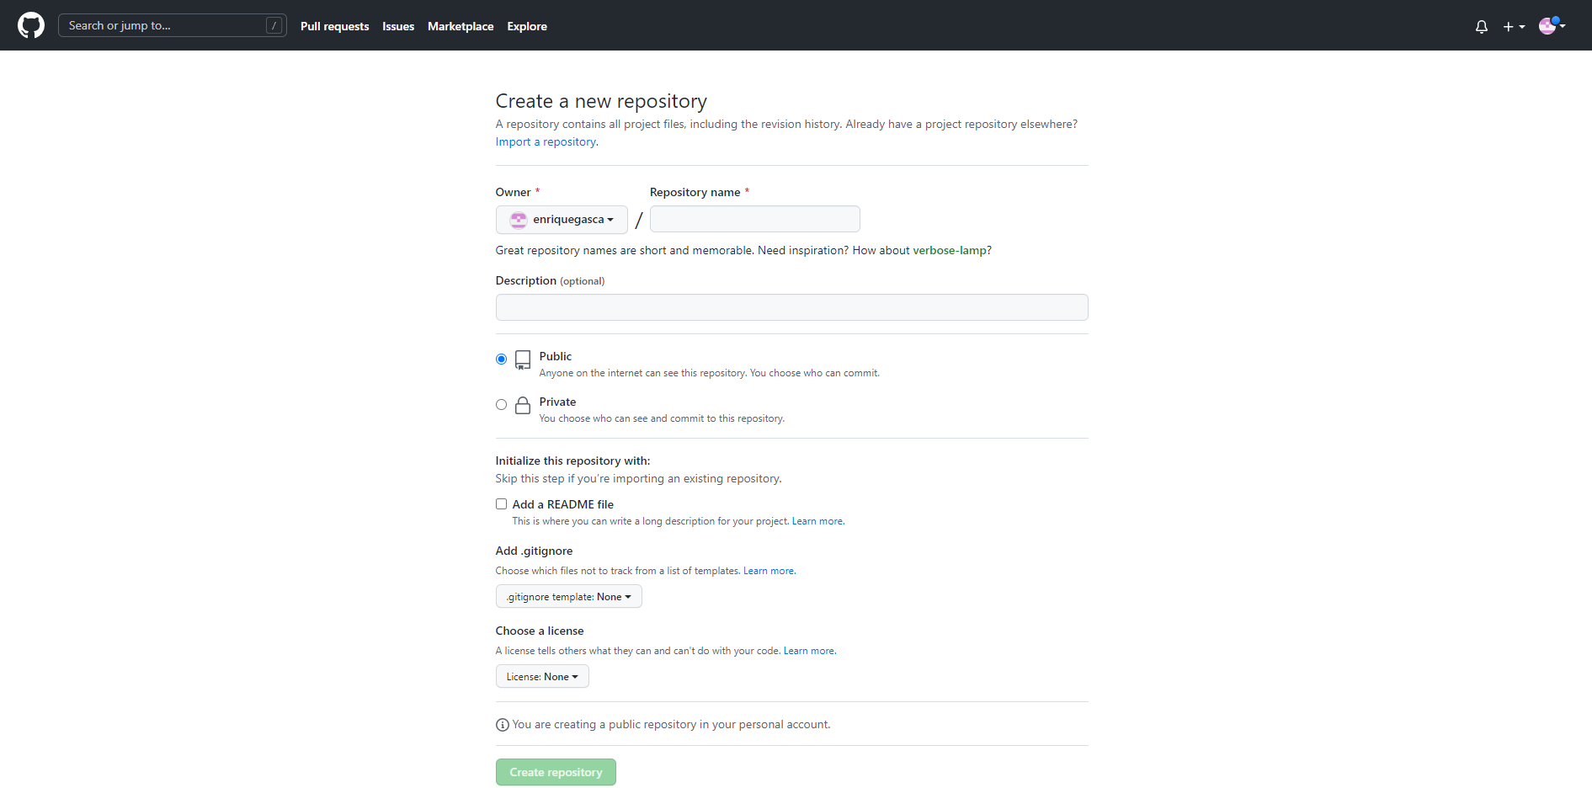
YourUsername
Insert your file name here
Select “Public”
Description
Don’t touch any of these
Click here

Slide 6
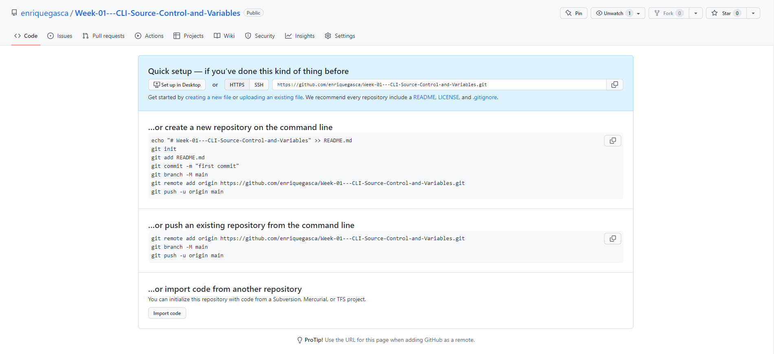
https://github.com/yourusername/Week-01---CLI-Source-Control-and-Variables.git
https://github.com/yourusername/week1Assignment.git
https://github.com/yourusername/week1Assignment.git

Slide 7
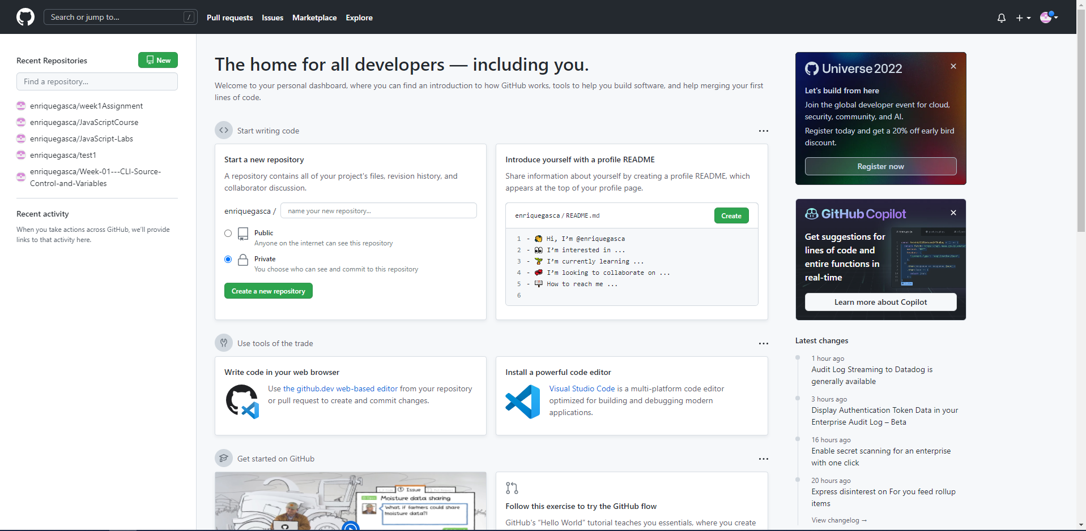


Slide 8
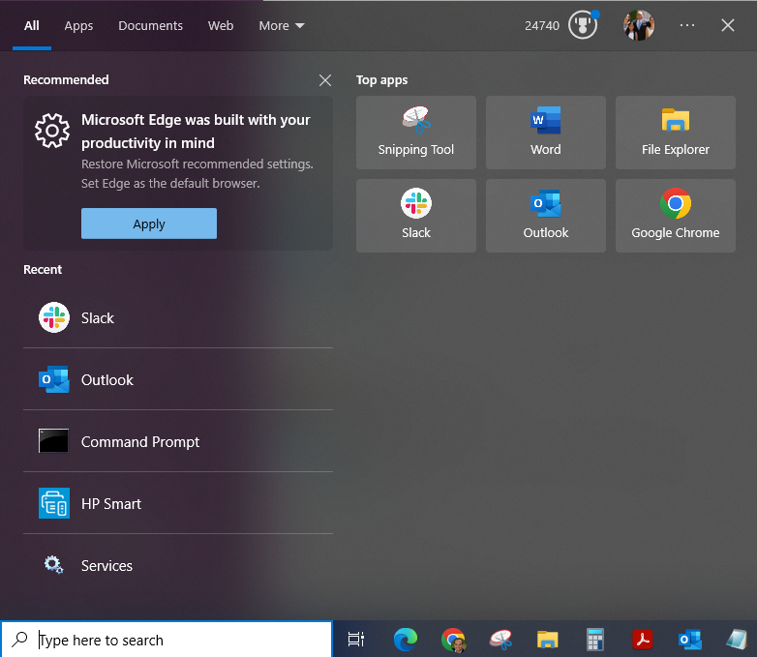
Type CMD

Slide 9
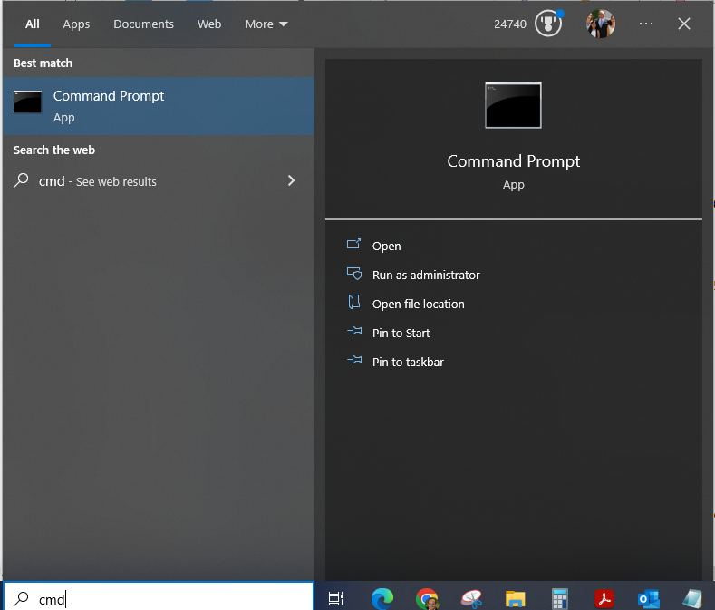
Click here

Slide 10
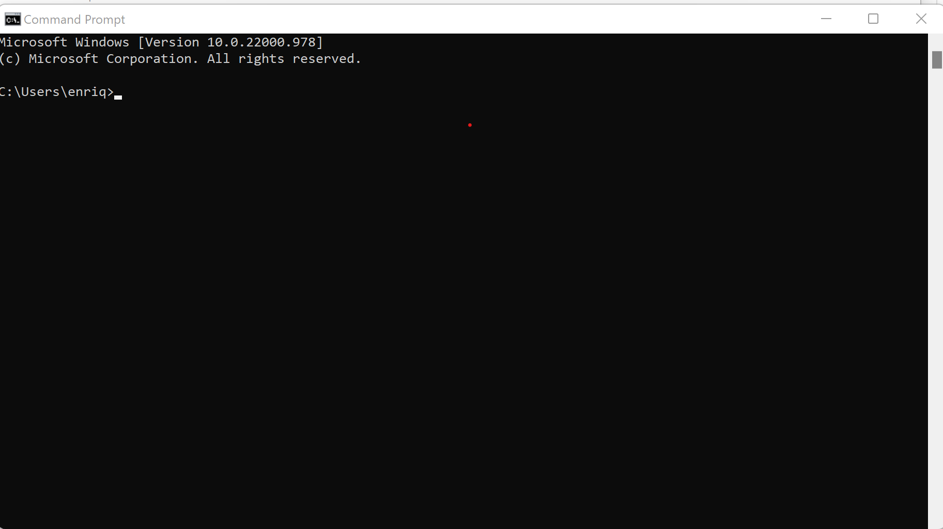
Notes:
Go to your CMD line and enter dir

Slide 11
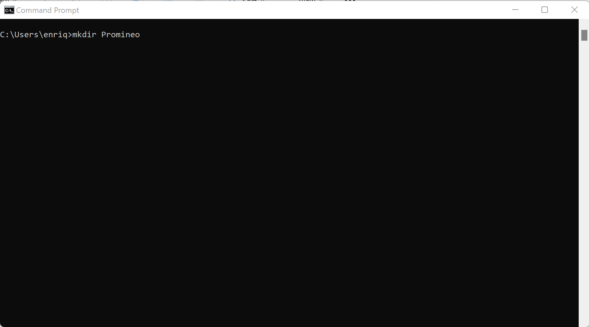
Notes:
Make directory called “Promineo”

Slide 12


Slide 13
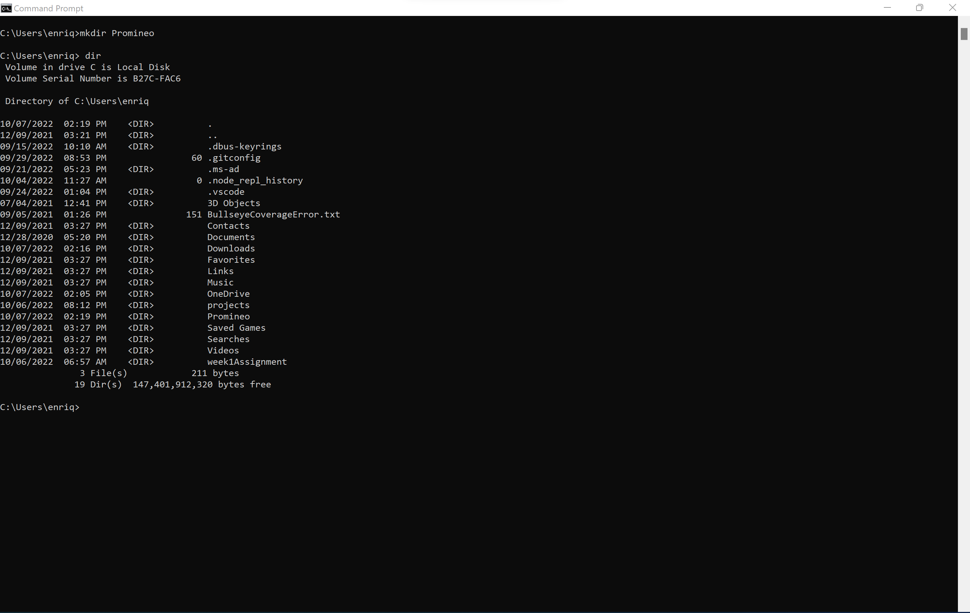
Here it is.

Slide 14
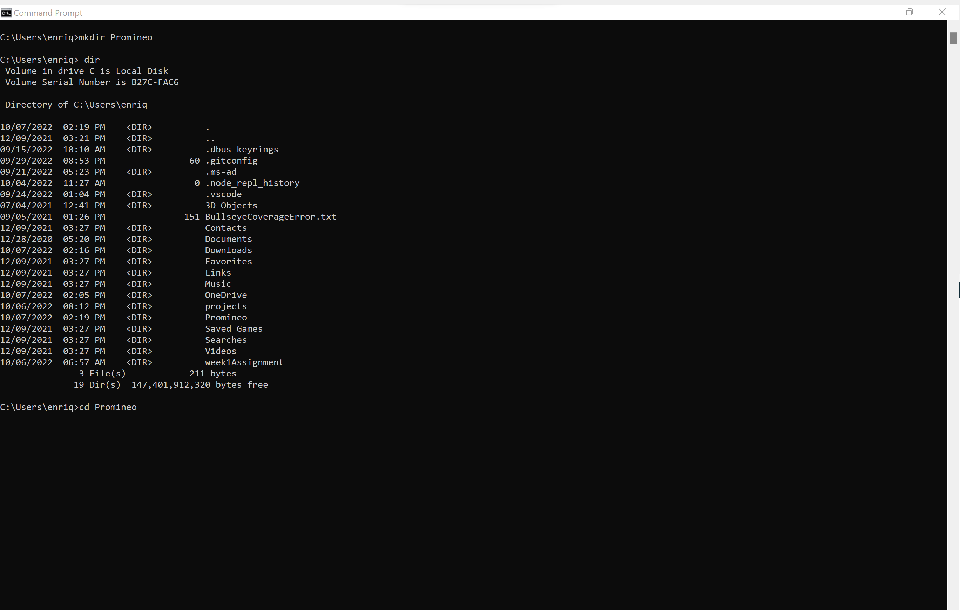
We want to work in this directory.
Key in: cd Promineo

Slide 15
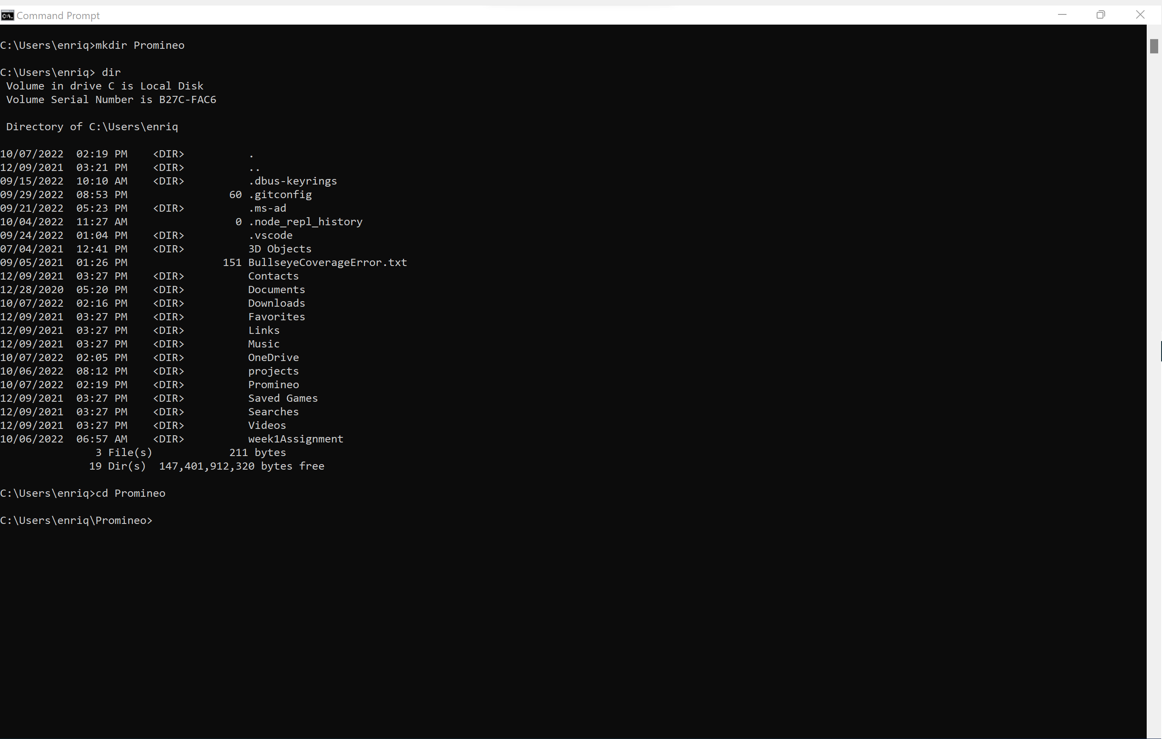
You will get this

Slide 16
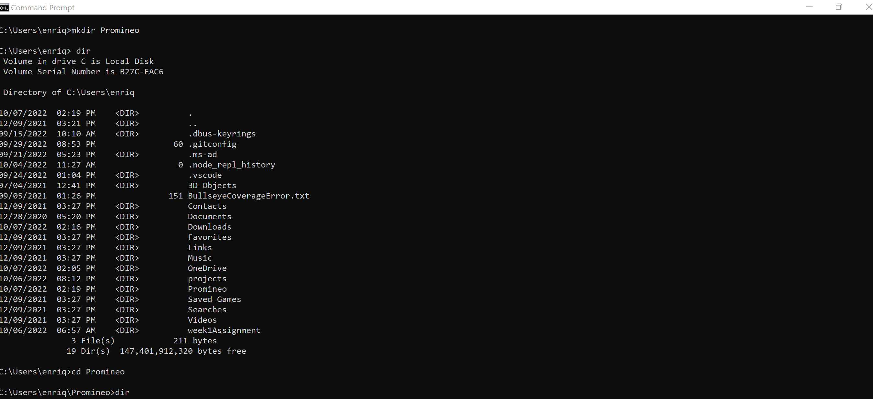
To see what’s in this directory,
Key in: dir

Slide 17
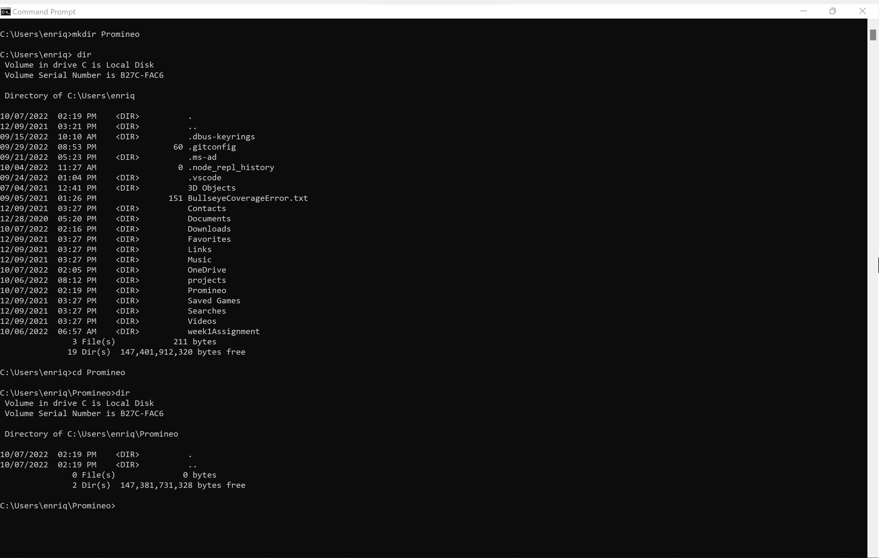
You will get this. There is a Promineo directory/folder but nothing is in there.

Slide 18
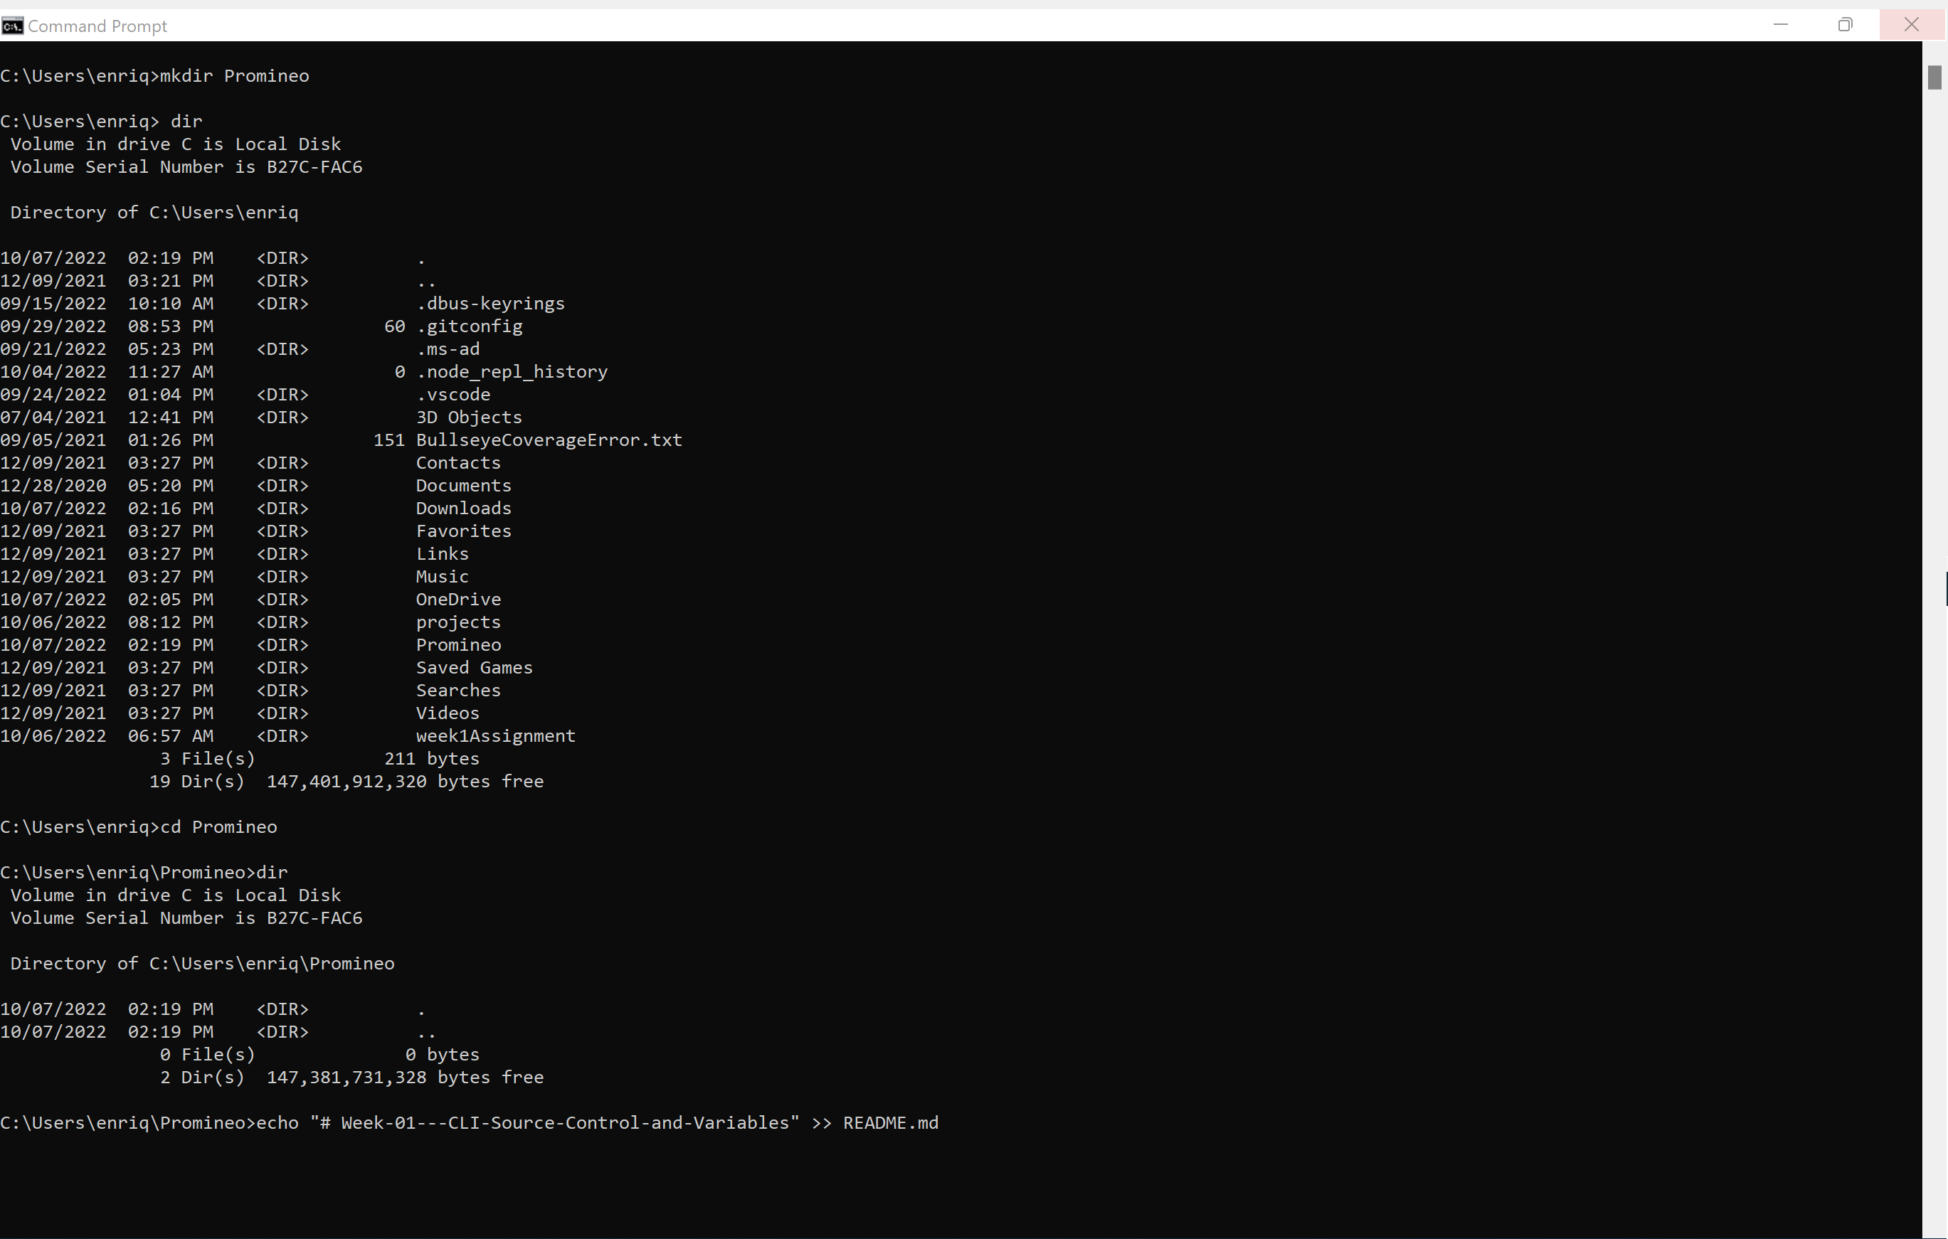
Create a file named README.md
Key in: echo "# Week-01---CLI-Source-Control-and-Variables" >> README.md

Slide 19
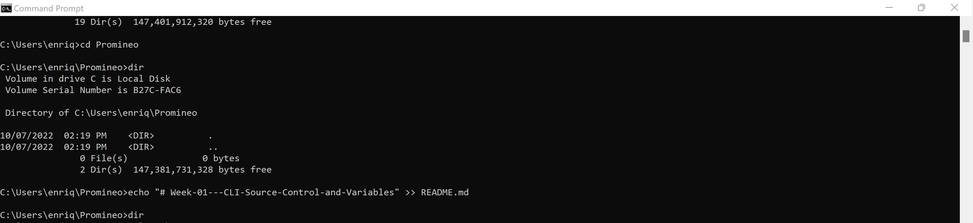
Done. To see where it is in the directory,
Key in: dir

Slide 20
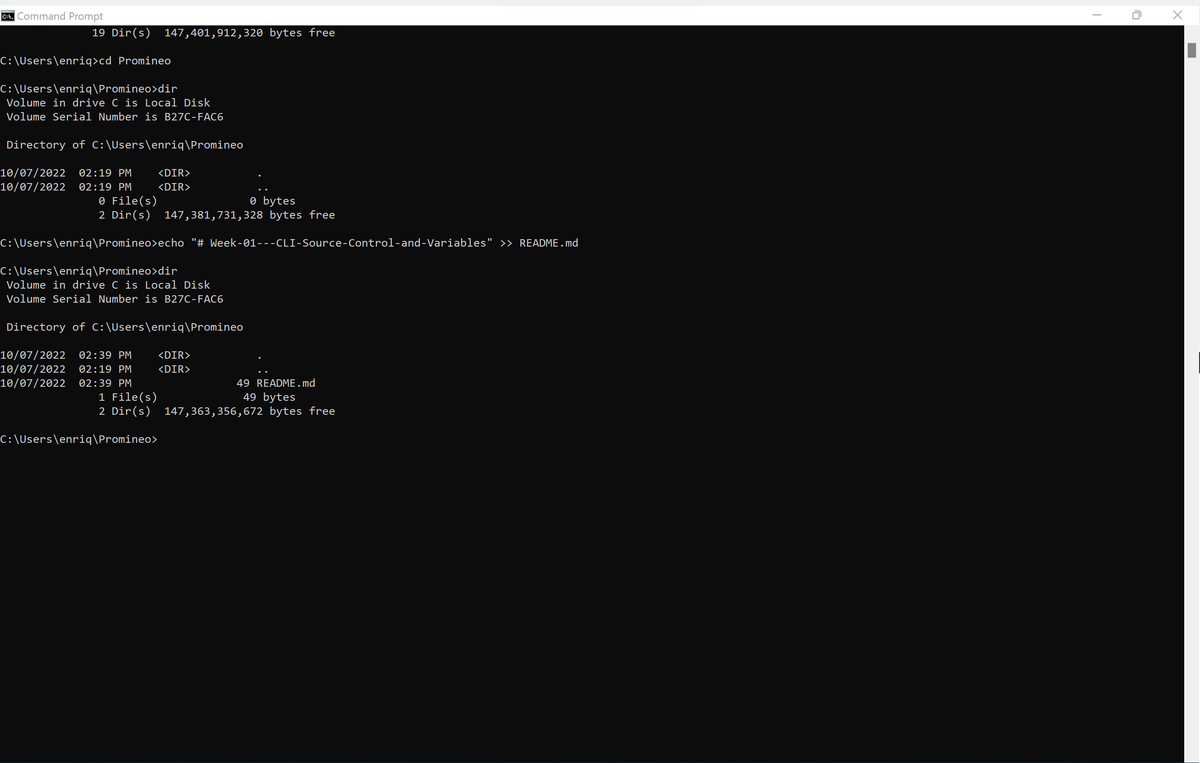
Here is our README.md file in the folder.

Slide 21
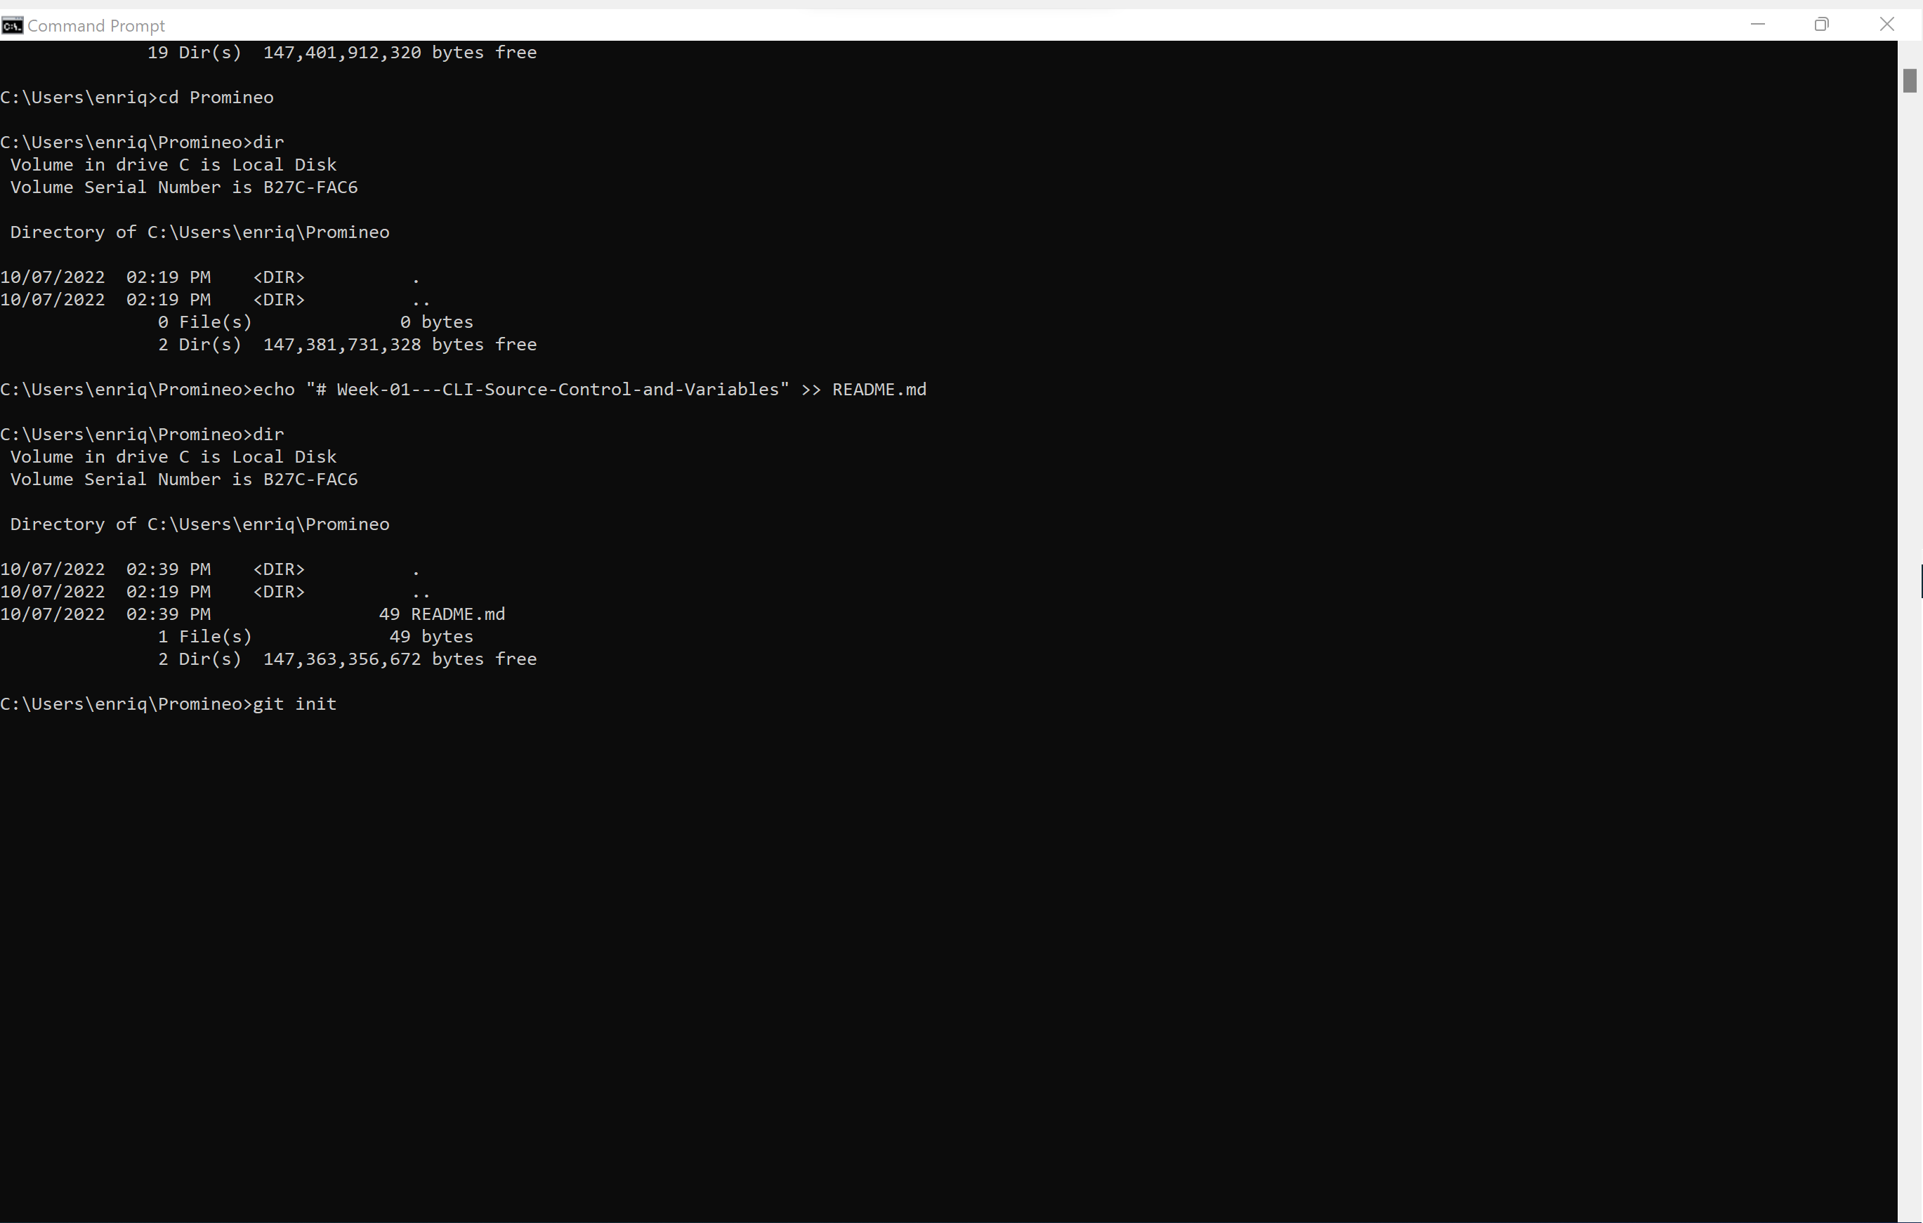
Now we need to initialize a data transfer from our Promineo folder on our hard drive to GitHub.
Key in: git init

Slide 22
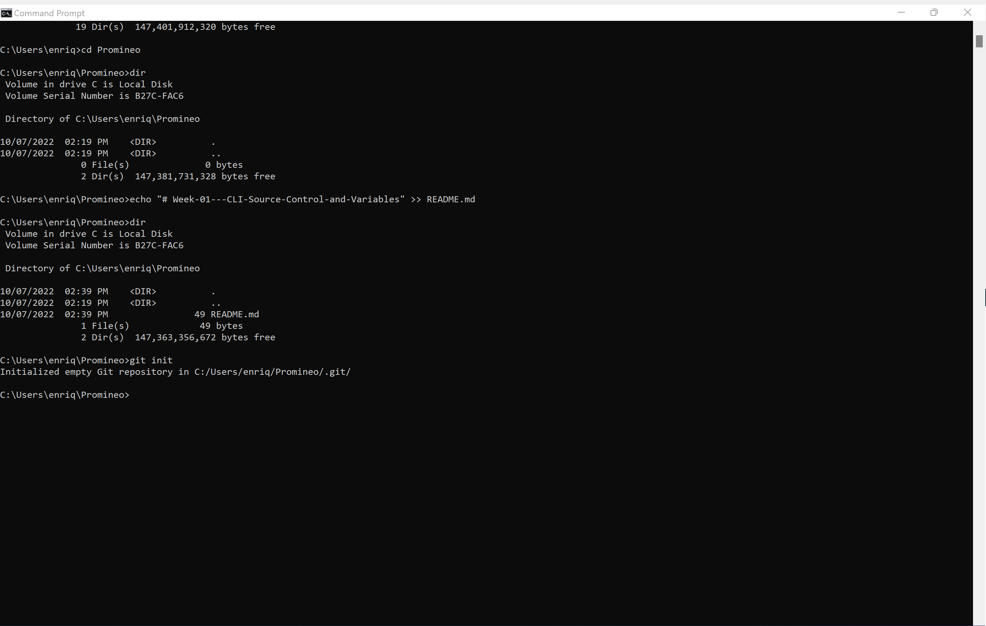
Now we are ready.

Slide 23
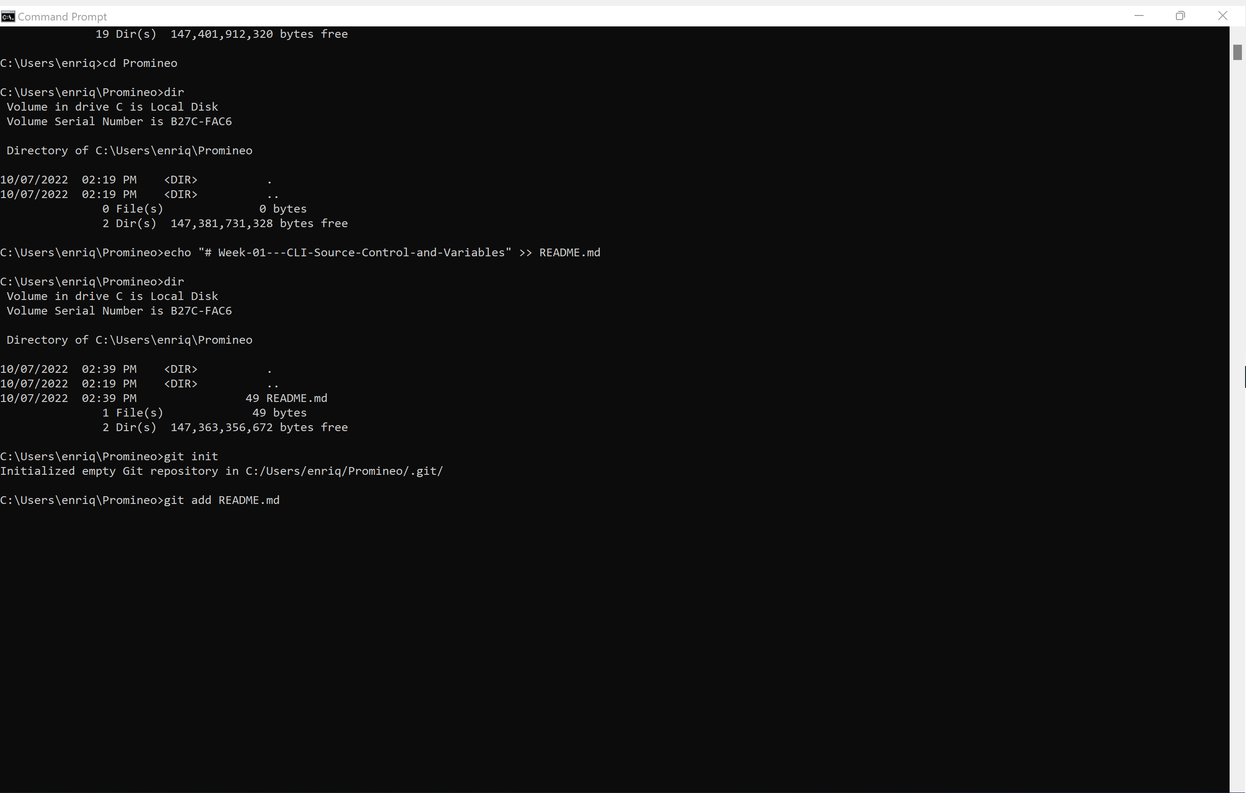
We’re going to add our README.md file
Key in: git add README.md
*if we have more than while file to add we can use: git add .

Slide 24
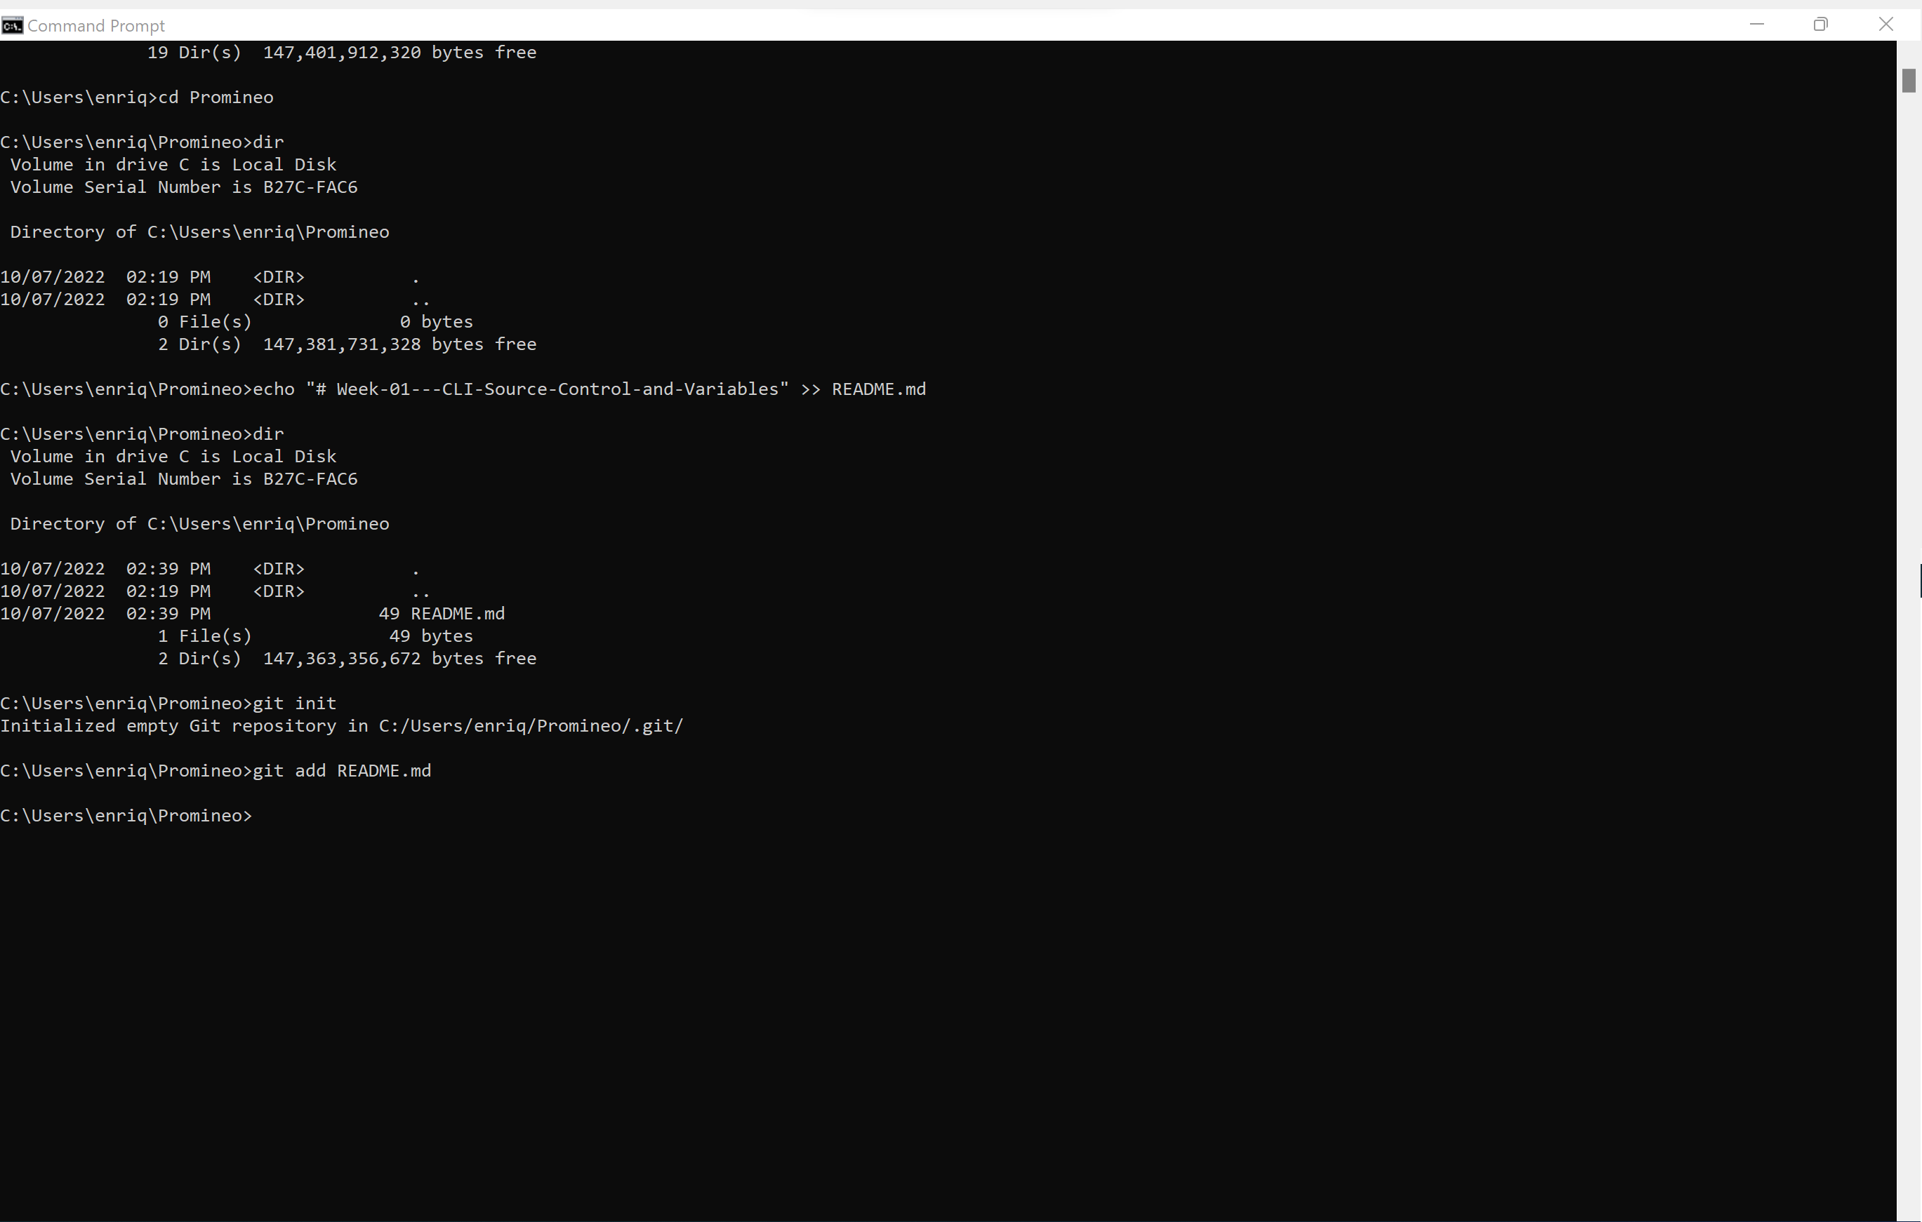
The previous action has prepared the file. Now we want to make sure it’s ready for transfer

Slide 25
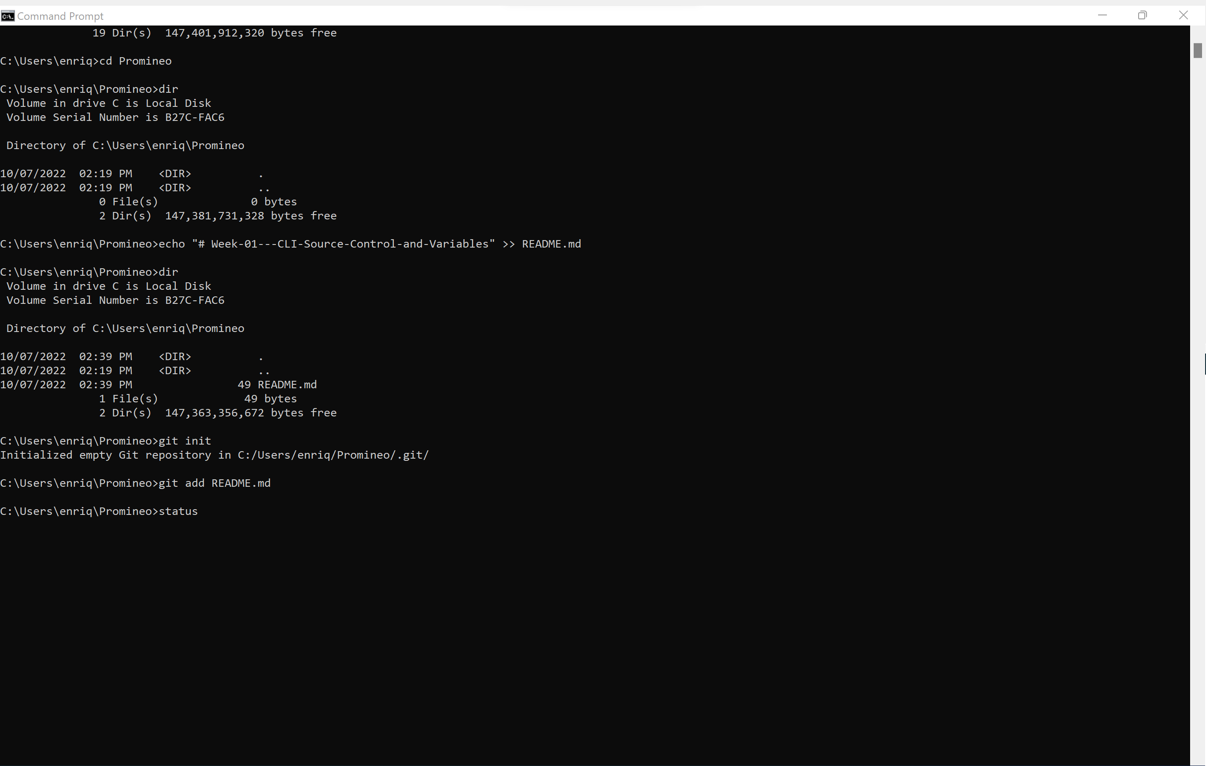
Key in: git status

Slide 26
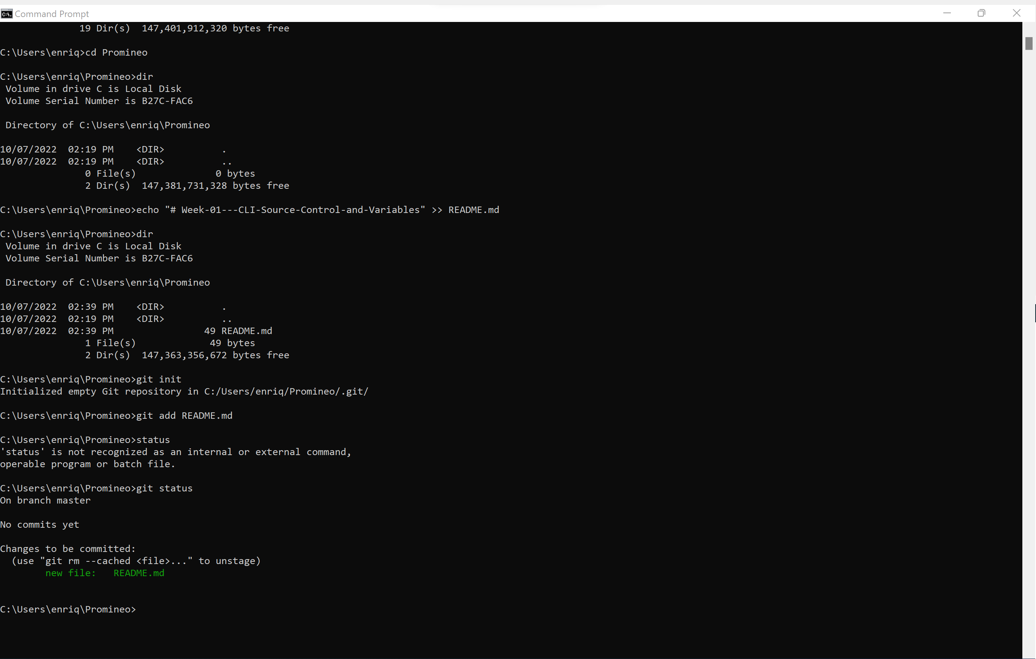
README.md file is prepared to be committed. We need to push it to Git Hub

Slide 27
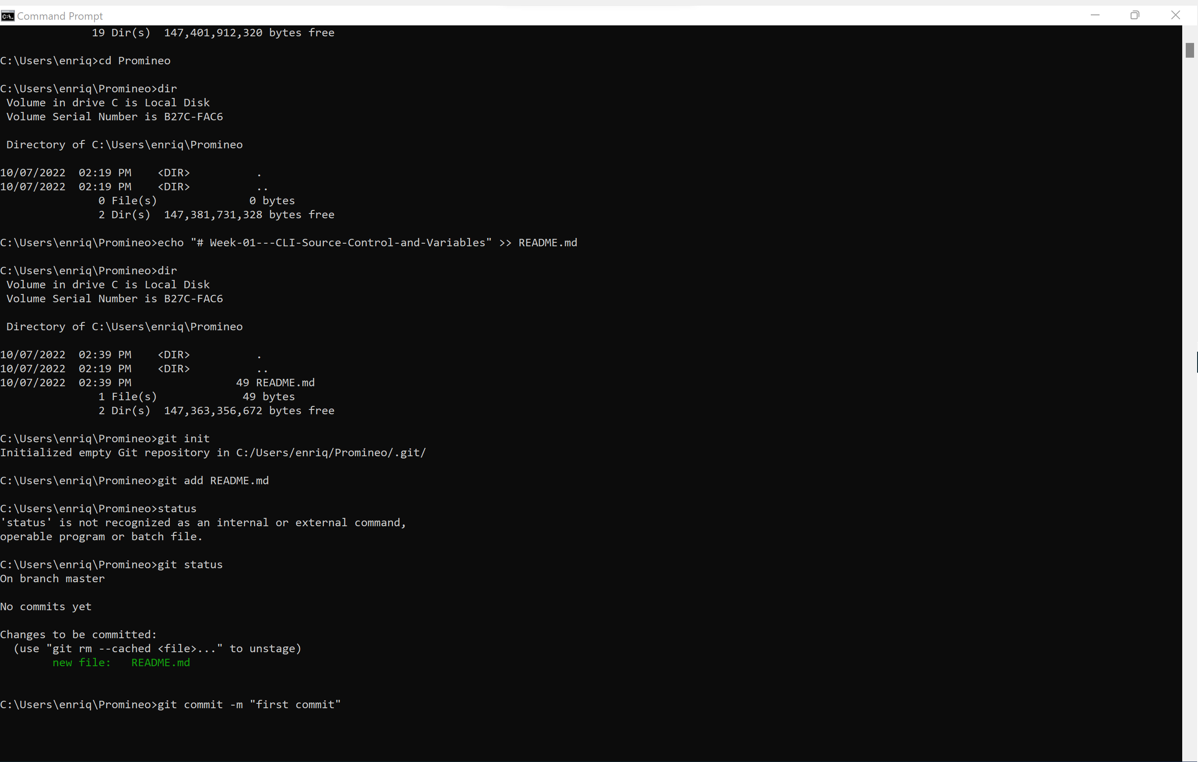
We need to give the command and we want to describe what to tell the team what we transferred over.
Key in: git commit –m “first commit”

Slide 28
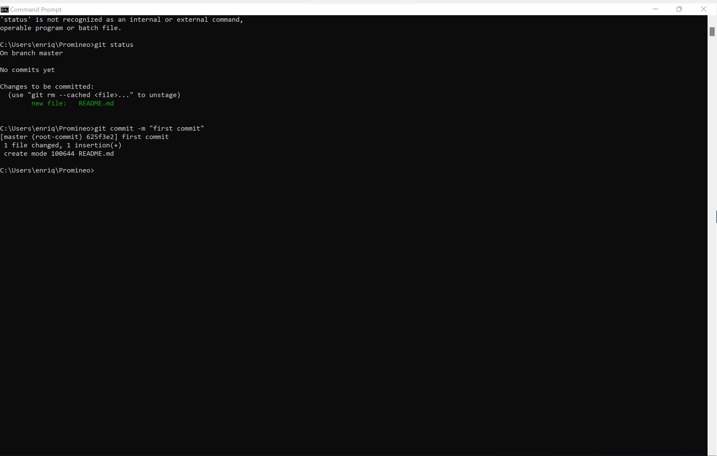
README.md file is committed.

Slide 29
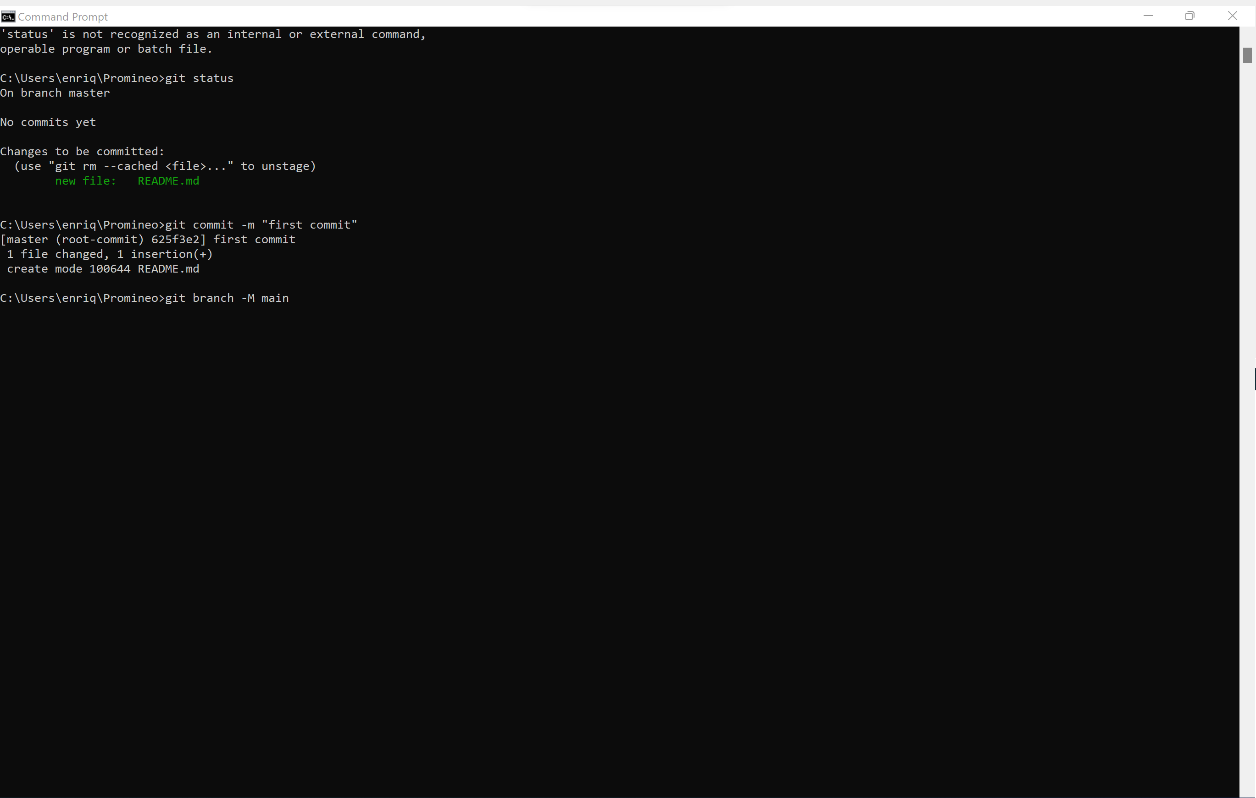
Let’s tell our computer that it needs to go into the main branch.
Key in: git branch –M main”

Slide 30
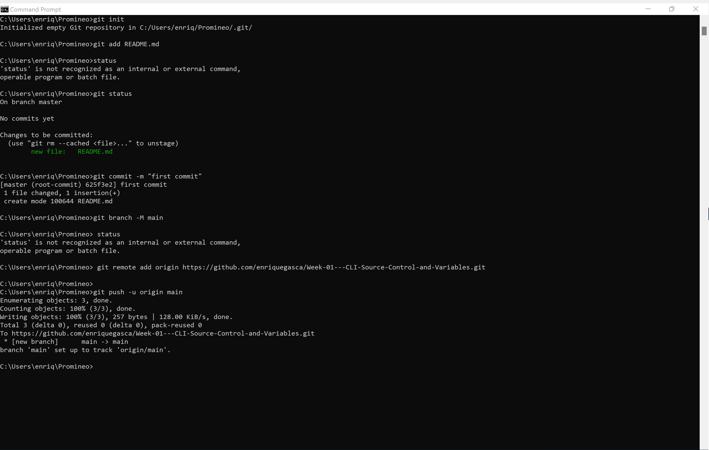
git remote add origin https://github.com/enriquegasca/Week-01---CLI-Source-Control-and-Variables.git
Let’s tell our computer what folder to put it in Git Hub.
Key in: git remote add origin https://github.com/enriquegasca/Week-01---CLI-Source-Control-and-Variables.git
”

Slide 31
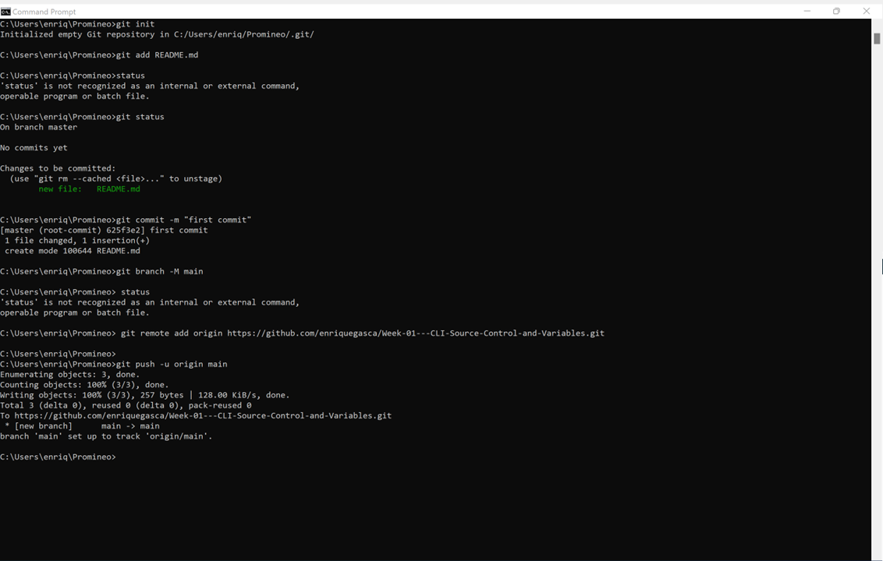
It’s prepped. Now let’s push it.
Key in: git push -u origin main

Slide 32
Done!

Slide 33
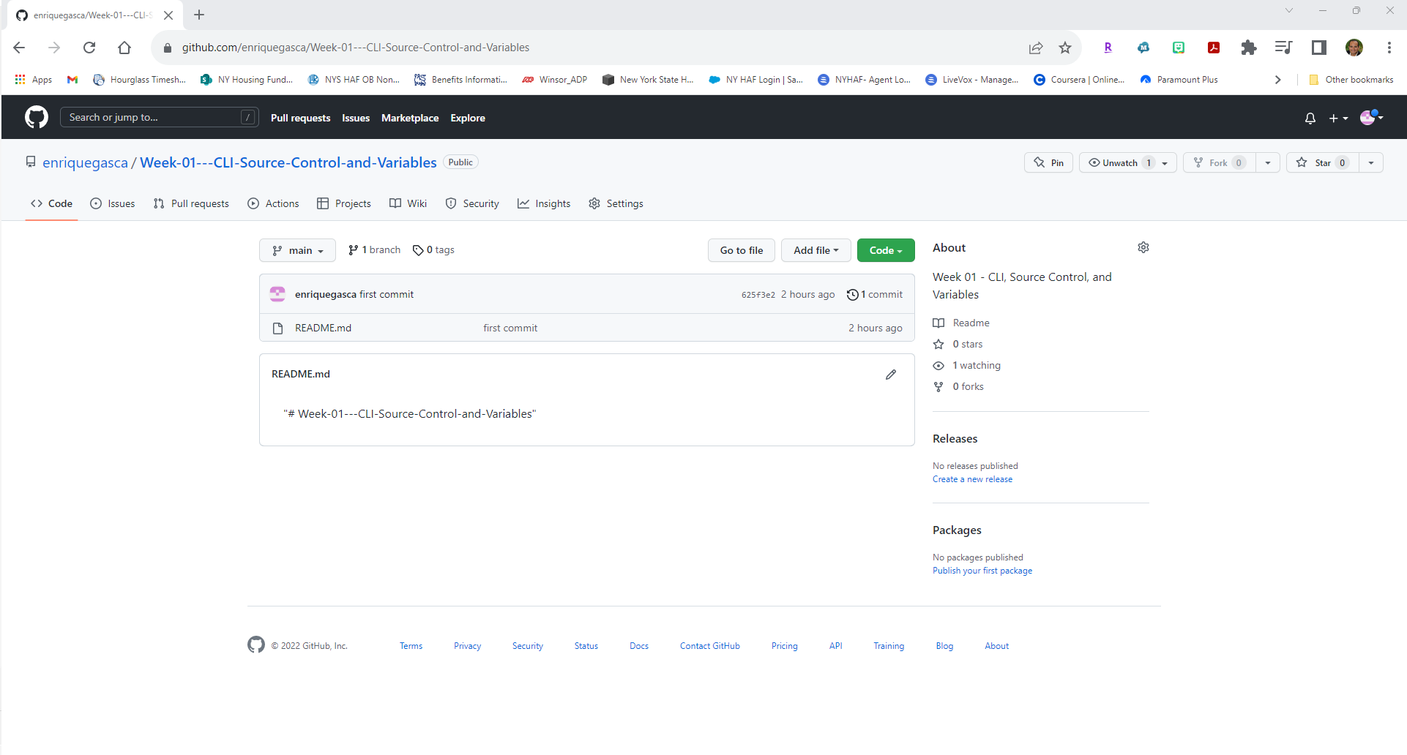
Here it is!

Slide 34
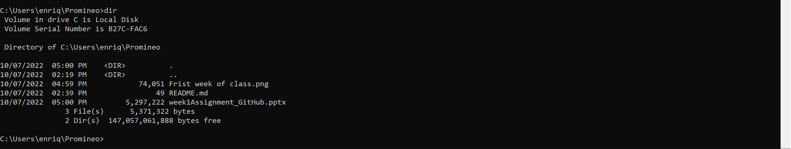
Added three more files in my computer’s Promineo folder that need to be committed to Git Hub.

